Slide 1
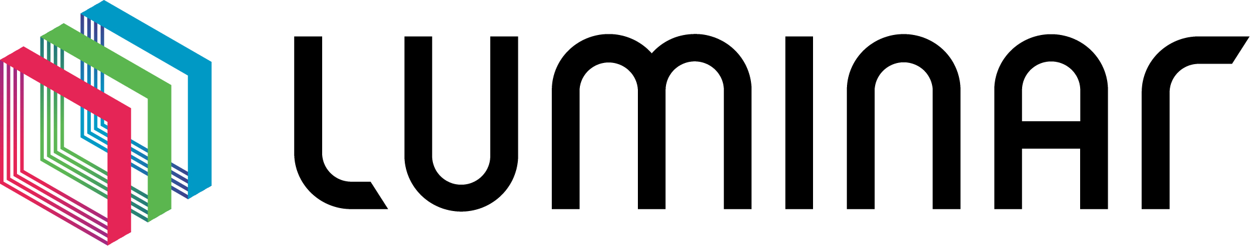
Integrating Adobe Firefly with Brand AI Chatbot
A Strategic Approach for Luminar
James Laughlin – Adobe Inc.

Slide 2
Understanding Luminar’s Needs

Slide 3

Understanding Luminar’s Needs
Key needs:
On-brand text/image/video generation
Secure and scalable AI integration
Elegant integration with existing/proposed systems
Key challenges:
Understanding the current AI architecture
Documenting all proposed requirements
Integrating Adobe’s AI tools with internal APIs, systems & any third-party solutions
Training the business on use of new AI tools
Notes:
Every successful integration starts with understanding the business needs,
and for Luminar, that means aligning technical capabilities with strategic goals
We’re going to spend a lot of time on this
This is foundational
Critical to the success of the project.
On-brand content is critical for maintaining identity across channels.
Security and scalability are non-negotiable,
You’re not just building tech – you’re building trust through seamless, secure integration.
If it doesn’t make the creative teams smile and the IT folks sleep at night, it’s not really a solution, right?

Slide 4
Overview of Firefly Services APIs

Slide 5
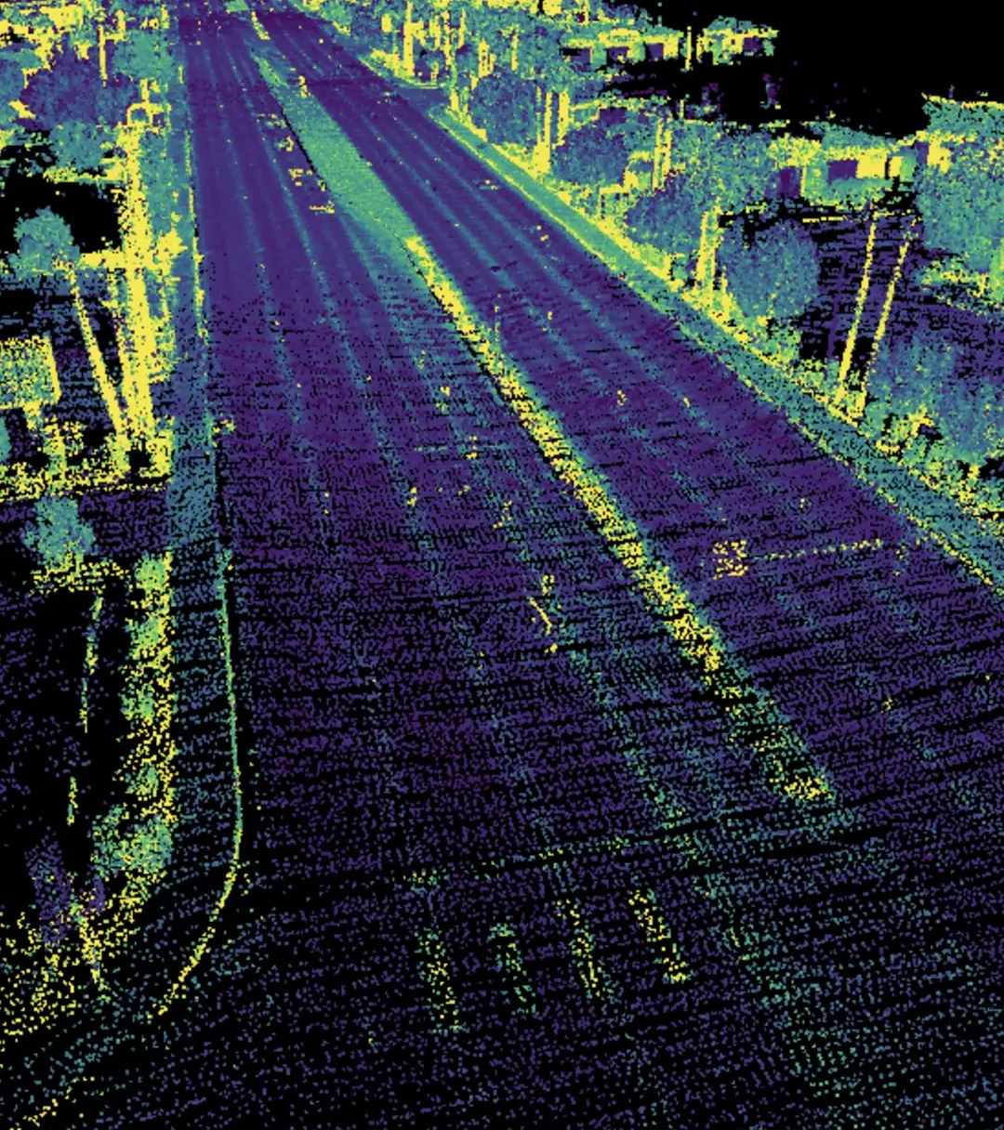
Overview of Firefly Services APIs
Firefly APIs enable image, vector, and template generation aligned with brand styles and voice.
Supports reference image styling and prompt-based content creation.
Ideal for automation, dynamic content, and branded asset/copy production.
Key capabilities: text-to-image, generative fill, template remixing, copy generation.
Seamless integration with Adobe Express, AEM, and Creative Cloud assets.
Notes:
Firefly APIs are the creative engine here,
providing a wide range of capabilities that are
as versatile as they are powerful.”
This is where we give your chatbot a double major in graphic design and creative writing.
Image, vector, and template generation
this is the core value of Firefly.
Its all available through the API
There’ also the seamless integration with Adobe’s other products
Express,
AEM
Creative Cloud
I like to think of this as giving your chatbot a superpower –
the ability to not just talk, but create."

Slide 6
Proposed Architecture & API Management

Slide 7

Proposed Architecture & API Management
AI Chatbot → Internal API Gateway → Firefly Services & LLMs.
Custom API gateway allows routing, throttling, and observability.
Incorporates Adobe Express/AEM for content deployment.
Security: OAuth2, Adobe Identity integration, third-party SSO, rate limiting.
Scalable via containerized microservices or serverless (e.g., AWS Lambda, Azure Functions).
Notes:
Now, all this creativity needs a solid pipeline to flow through,
and that’s where the architecture comes in.
Your API Gateway is the backbone
it’s the digital traffic cop keeping everything flowing smoothly.
It must be done right
Security
We support oAuth2
SSO through Adobe sign or your 3rd party SSO
Rate limiting – limits overuse due to DDoS
Think of this as the difference between a garden hose and a fire hose – we’re building the latter.

Slide 8
Integration Strategy & Validation

Slide 9

Integration Strategy & Validation
Phase 0: Information gathering and documentation of requirements
Notes:
Integration Strategy & Validation
Integration is where the magic really happens – connecting all these moving parts into a seamless experience."
Personal Touch: "This is where we go from 'proof of concept' to 'proof of awesome.'"
Main Points:
Phase 0
is where we get our ducks in a row.
We do all the discovery and document all of the requirements

Slide 10
Integration Strategy & Validation
Phase 0: Information gathering and documentation of requirements
Phase 1: PoC with Firefly API (image generation) and prompt engineering.
Notes:
Slide 4: Integration Strategy & Validation
Integration is where the magic really happens – connecting all these moving parts into a seamless experience."
Personal Touch: "This is where we go from 'proof of concept' to 'proof of awesome.'"
Main Points:
Phase 0
is where we get our ducks in a row.
We do all the discovery and document all of the requirements
Phase 1 – Image Generation
is where we do our proof of concept for images
This will let us know if we’ve done a good job in phase 0

Slide 11
Integration Strategy & Validation
Phase 0: Information gathering and documentation of requirements
Phase 1: PoC with Firefly API (image generation) and prompt engineering.
Phase 2: Connect chatbot with internal gateway to route AI tasks.
Notes:
Slide 4: Integration Strategy & Validation
Integration is where the magic really happens – connecting all these moving parts into a seamless experience."
Personal Touch: "This is where we go from 'proof of concept' to 'proof of awesome.'"
Main Points:
Phase 0
is where we get our ducks in a row.
We do all the discovery and document all of the requirements
Phase 1 – Image Generation
is where we do our proof of concept for images
This will let us know if we’ve done a good job in phase 0
Phase 2
here we connect the PoC to your chatbot through your custom gateway
If there are performance issues with the gateway approach, we’ll uncover them here.

Slide 12
Integration Strategy & Validation
Phase 0: Information gathering and documentation of requirements
Phase 1: PoC with Firefly API (image generation) and prompt engineering.
Phase 2: Connect chatbot with internal gateway to route AI tasks.
Phase 3: Integrate LLM for on-brand text via fine-tuning or guardrails.
Notes:
Slide 4: Integration Strategy & Validation
Integration is where the magic really happens – connecting all these moving parts into a seamless experience."
Personal Touch: "This is where we go from 'proof of concept' to 'proof of awesome.'"
Main Points:
Phase 0
is where we get our ducks in a row.
We do all the discovery and document all of the requirements
Phase 1 – Image Generation
is where we do our proof of concept for images
This will let us know if we’ve done a good job in phase 0
Phase 2
here we connect the PoC to your chatbot through your custom gateway
If there are performance issues with the gateway approach, we’ll uncover them here.
Phase 3 – LLM for copy generation
is where we do for text what we did for images in phase 1

Slide 13
Integration Strategy & Validation
Phase 0: Information gathering and documentation of requirements
Phase 1: PoC with Firefly API (image generation) and prompt engineering.
Phase 2: Connect chatbot with internal gateway to route AI tasks.
Phase 3: Integrate LLM for on-brand text via fine-tuning or guardrails.
Phase 4: UI development and integration with existing interface.
Notes:
Slide 4: Integration Strategy & Validation
Integration is where the magic really happens – connecting all these moving parts into a seamless experience."
Personal Touch: "This is where we go from 'proof of concept' to 'proof of awesome.'"
Main Points:
Phase 0
is where we get our ducks in a row.
We do all the discovery and document all of the requirements
Phase 1 – Image Generation
is where we do our proof of concept for images
This will let us know if we’ve done a good job in phase 0
Phase 2
here we connect the PoC to your chatbot through your custom gateway
If there are performance issues with the gateway approach, we’ll uncover them here.
Phase 3 – LLM for copy generation
is where we do for text what we did for images in phase 1
Phase 4
We put a pretty face on it
Not just UI development – this is UX development
Seamless integration with existing UI
As easy as possible for your users to be up and running from the gun

Slide 14
Integration Strategy & Validation
Phase 0: Information gathering and documentation of requirements
Phase 1: PoC with Firefly API (image generation) and prompt engineering.
Phase 2: Connect chatbot with internal gateway to route AI tasks.
Phase 3: Integrate LLM for on-brand text via fine-tuning or guardrails.
Phase 4: UI development and integration with existing interface.
Validation: brand review, stakeholder feedback, performance tests.
Notes:
Integration Strategy & Validation
Integration is where the magic really happens – connecting all these moving parts into a seamless experience."
Personal Touch: "This is where we go from 'proof of concept' to 'proof of awesome.'"
Main Points:
Phase 0
is where we get our ducks in a row.
We do all the discovery and document all of the requirements
Phase 1 – Image Generation
is where we do our proof of concept for images
This will let us know if we’ve done a good job in phase 0
Phase 2
here we connect the PoC to your chatbot through your custom gateway
If there are performance issues with the gateway approach, we’ll uncover them here.
Phase 3 – LLM for copy generation
is where we do for text what we did for images in phase 1
Phase 4
We put a pretty face on it
Not just UI development – this is UX development
Seamless integration with existing UI
As easy as possible for your users to be up and running from the gun
Validation and UAT
Here we find out if the business has any tweaks they’d like to make
If we’ve done our job right there should be no surprises here
Although we do expect some tweaks to come up at this time

Slide 15
Maintenance & Scaling Considerations
Notes:
Finally,
Maintenance and Scaling considerations

Slide 16

Maintenance & Scaling Considerations
Automated testing pipelines for API and model updates.
Version control and fallbacks for Firefly APIs.
Monitoring via API gateway and usage dashboards.
Scalable storage for assets, caching strategies for high-demand prompts.
Plan for feedback loops to refine prompt engineering continuously.
Notes:
Finally,
Maintenance and Scaling considerations
Once it’s built, you have to keep it running smoothly – because scaling isn’t just about adding servers, it’s about building a smarter system."
automated testing,
version control,
and smart scaling when needed
To stay within financial limits.
you can’t just throw more servers and code at the problem – you need to be smart about it.

Slide 17
Q&A and Demo

Slide 18
Closer Slide

Slide 19
Closer Slide

Slide 20
Closer Slide

Slide 21
Things I’d like to have done better

Slide 22
Things I’d like to have done better
Additional routes in the code to:
Generate images from a sample
Demo generative fill capabilities
Generate on-brand copy from a sample image
Include a feedback feature so that Firefly can learn from what I’m seeing
“more like this”
“that child’s eyes are not closed”

